Slide 1
What’s “Land Grant” at UTTC?
The history and how we’re making it.
Brian McGinness, M.Ed: Land Grant Director

Slide 2
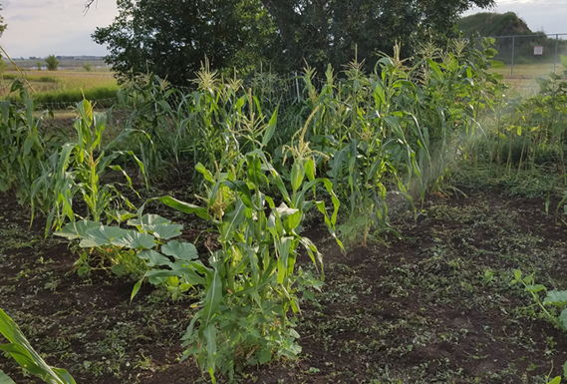
Corn Thumbprint Cookies
Made from our own UTTC corn!
Makes 11 cookies.
- 1/3 cup (50g) fine cornmeal
- ½ cup (120g) sunflower seeds, unsalted
-3 tablespoons maple syrup
-¼ teaspoon sea salt
-1 ½ tablespoons warm water
-2 tablespoons of jam
Preheat oven to 350⁰F.
Toast cornmeal in a dry skillet until fragrant. Place in a bowl and set aside.
Toast sunflower seeds in the same manner.
Blend sunflower seeds, maple syrup, and sea salt in a food processor until it is the consistency of peanut butter. Add warm water and give it a final blend.
Combine sunflower seed mixture with cornmeal in a bowl.
Scoop a tablespoon of the dough, roll it into a ball, and place it on a parchment lined sheet tray. Slightly flatten the cookie with your palm. Finish forming the cookie by making a well in the middle with your finger or the end of a cooking utensil. Repeat with the remaining dough.
If your jam is a bit runny, reduce it on the stove in a sauté pan. Using a spoon, fill the wells of the cookies with the jam.
Bake for 10 minutes, or until slightly browned. Let cool and serve.

Slide 3
What’s “Land Grant” at UTTC?
The history and how we’re making it.
Brian McGinness, M.Ed: Land Grant Director

Slide 4
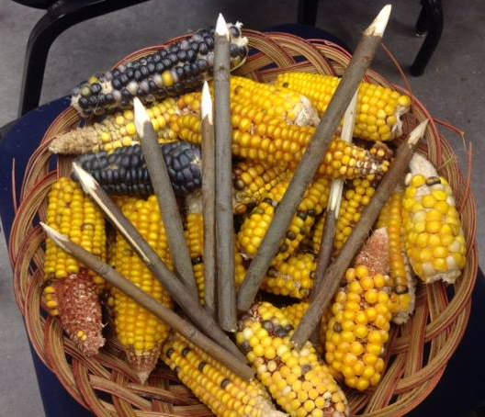

Slide 5
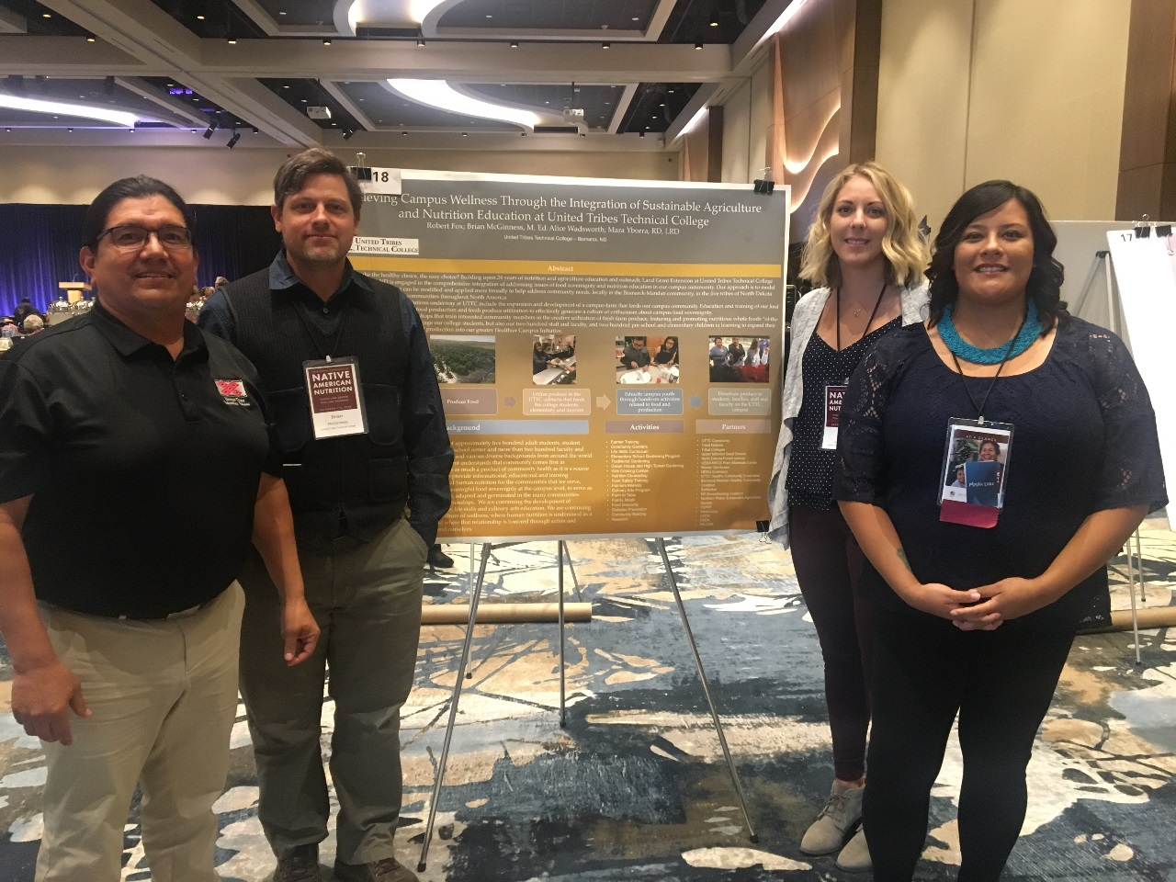
Why I’m Presenting To You Today
Introduce myself and the Land Grant team
Explain what “Land Grant” is
To share with you what we’re doing
To invite you to participate

Slide 6
Part 2: A bit of history…
25th Anniversary of the 1994 Land Grant for Tribal Colleges.
157 years for the Morrill Act of 1862.
Established a system to “promote liberal and practical education of the industrial classes… for the benefit of agriculture and mechanical arts”.

Slide 7
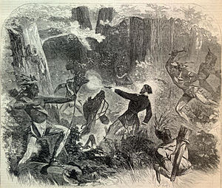
Part 2: A bit of history…
Historical context of the Morrill Act of 1862:
Civil War, Abraham Lincoln
Transcontinental Railroad one day before
Homestead Act two months prior
“Dakota War” and the inclusion of military tactics in the Act. (Stoney Lake)

Slide 8
Part 2: A bit of history…
1887 Hatch Act establishes research component of Land Grant colleges
1890 Land Grant to accommodate/address segregation
1914 Smith-Lever Act established extension component of land grant mission
1960’s, 1970’s and 1980’s “Insular Land Grant Colleges” (Guam, Puerto Rico, Washington, D.C., etc.)--- based on not being served by the Land Grant system
1994 AIHEC successfully lobbies for Land Grant status for tribal colleges

Slide 9
Part 2: A bit of history…
1994 AIHEC successfully lobbies for Land Grant status for tribal colleges: Equity in Educational Land-Grant Status Act of 1994
1996 Endowment Fund established in lieu of land
1996 Equity in Education grant to support instructional activities
1997 Extension Grant to support community outreach
2000 Research grant program established

Slide 10
Part 2: A bit of history…
2002 First AIHEC Land Grant Vision Statement:
As 1994 Land Grant Institutions in the 21st century, Tribal Colleges and Universities envision the revitalization of Tribal homelands and the self-sufficiency of America’s Indigenous families, communities, and Tribal Nations. 
The 1994 TLGCUs seek equitable opportunities to collaborate with institutions and organizations willing to commit to the needs and aspirations of Tribal People. 
Respecting traditional and new bases of knowledge, the 1994 TLGCUs seek partnership models embracing the uniqueness of TLGCUs and their integrated approaches toward land and human resources development through research, instruction, community outreach, and advocacy. 
The ultimate goal of the 1994 TLGCUs is to ensure the cultural, physical, economic, education, and spiritual well-being of past, present, and future generations of the America’s Indigenous people.

Slide 11
Part 2: A bit of history…
Holism: 1994 programs use integrated, multi-disciplinary and team-orientated approaches
Sacredness of land and food: 1994 programs emphasize environmental stewardship and sustainability
Cultural identity: 1994 programs promote understanding and respect of cultural differences and strengths
Cultural viability: 1994 programs seek problem-orientated solutions with direct benefits to their people.

Slide 12
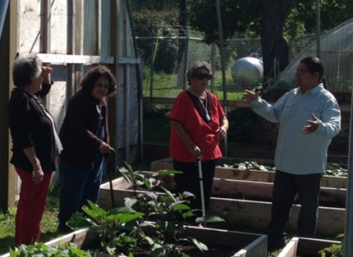
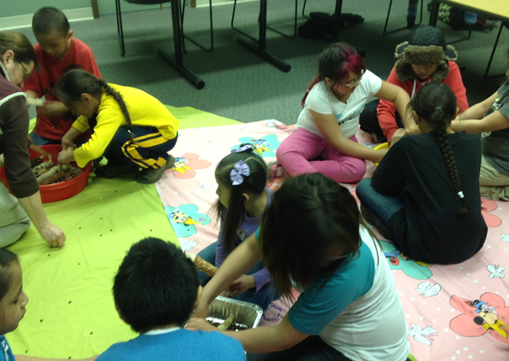
Part 3: What UTTC Land Grant Is Doing

Slide 13
Part 3: What UTTC Land Grant Is Doing
Holism, sacredness of land and food, cultural identity, and cultural viability are guiding our UTTC Land Grant Mission
Education, Research and Extension
Culinary, Nutrition and Agriculture

Slide 14
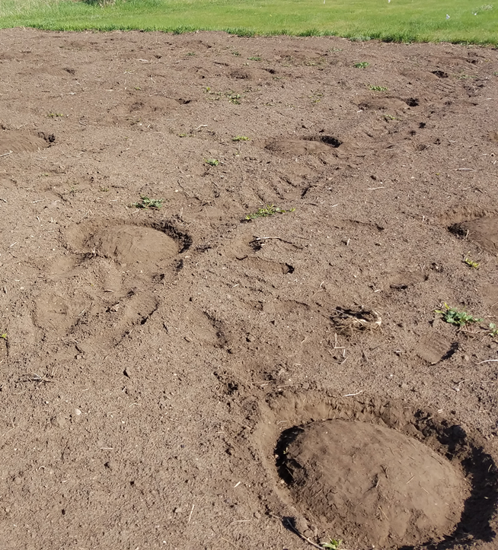
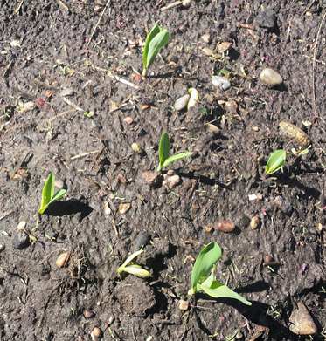
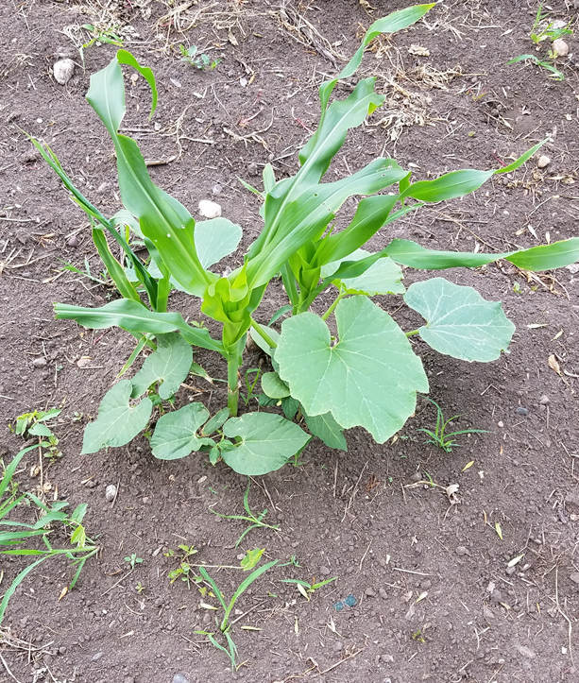
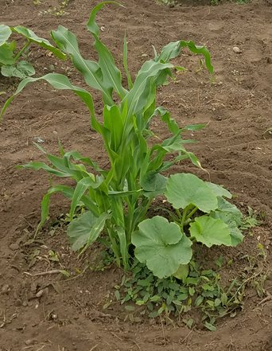
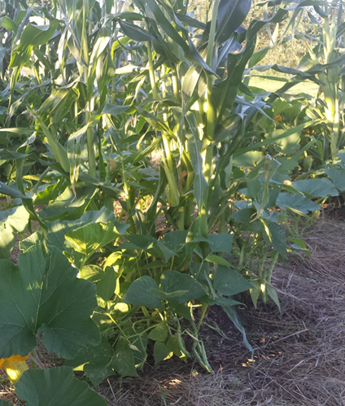

Slide 16
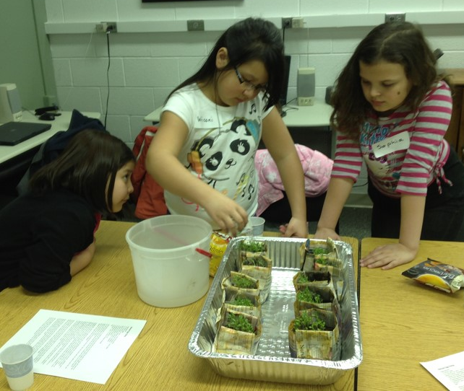
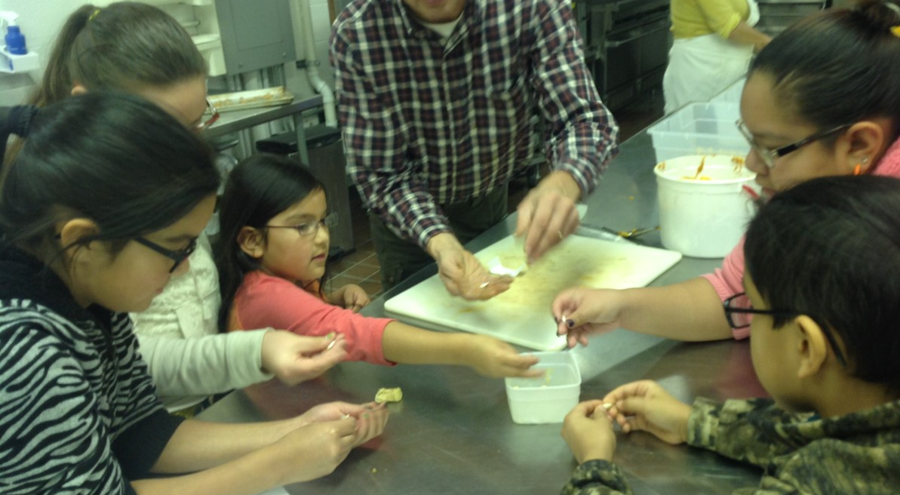
Part 3: What UTTC Land Grant Is Doing
Culinary Arts and Nutrition Academic Program
Nutrition counseling, Food handler safety and ServSafe training, FDPIR, BisMarket/Winter Market, Health and Wellness promotion and worksite wellness, Healthy Campus Community/Partnership for a Healthier America, TJES and Pre-school outreach
Campus gardens and distribution, aquaponics, Tree-Campus USA, youth orchard
Grant funded: Endowment, Extension, Equity, Research, Beginning Farmer and Rancher, Keepseagle, AIHEC, ND Forestry, FNS
Notes:
Robert- Germination of the seeds

Slide 17
Notes:
Robert

Slide 18
Part 3: What UTTC Land Grant Is Doing in 2019
Community Food Systems Academic Program
Technical growing skills
Campus community lab/interdisciplinary
Why “community food systems”
The act, the experience of getting food is fundamental to being human
Nourishment in mind, body and spirit
Community engagement is the crux of the program

Slide 19
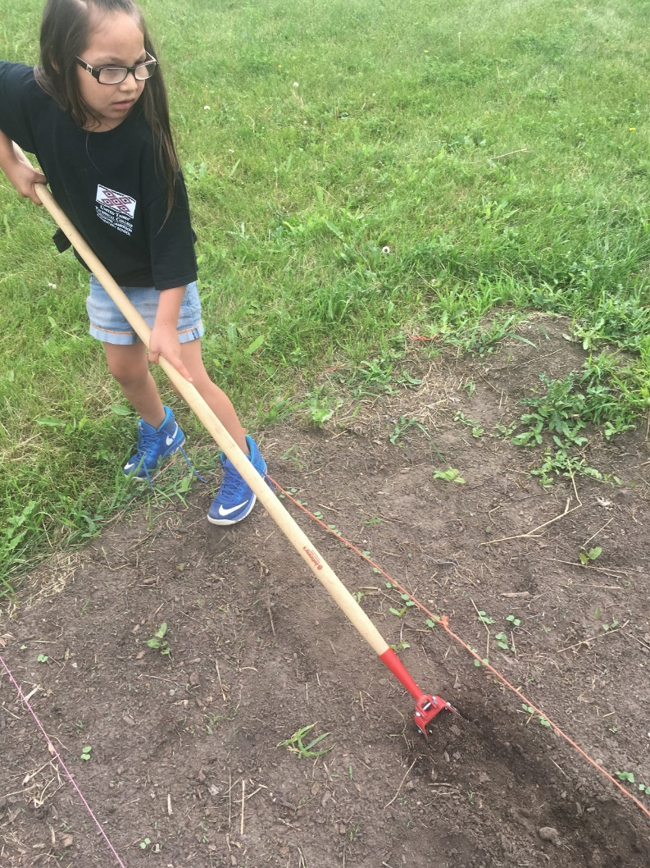
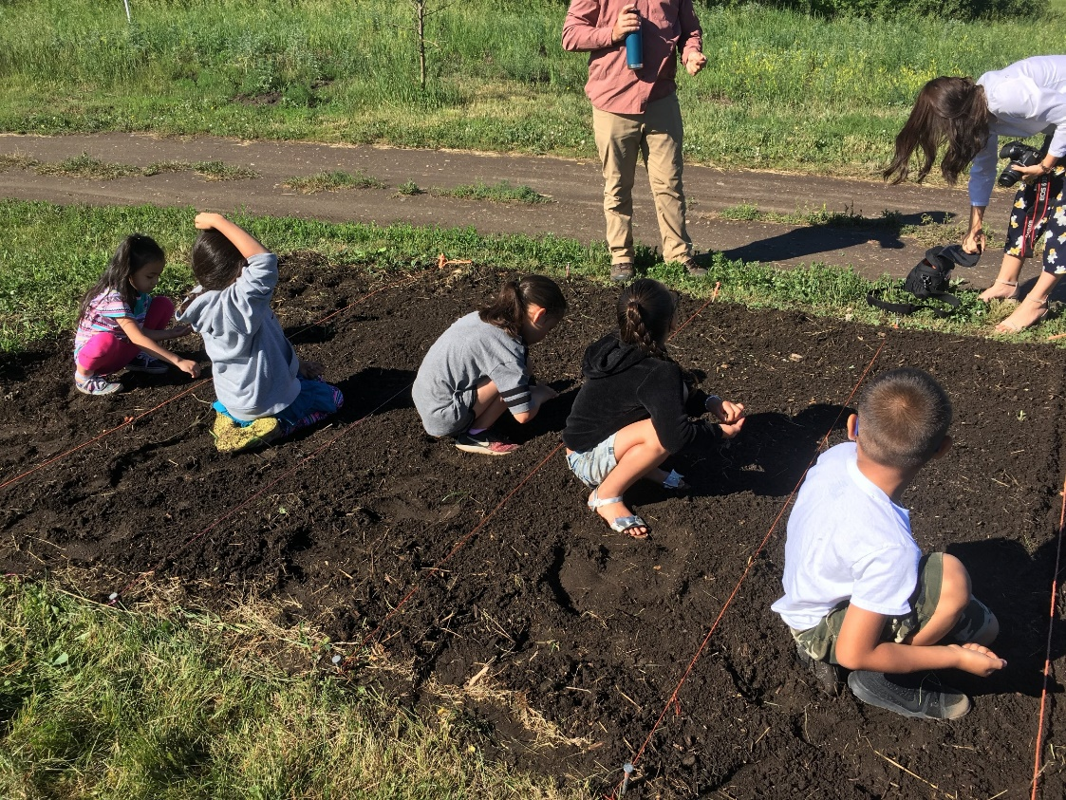
Notes:
Brian- present, planting a garden

Slide 20
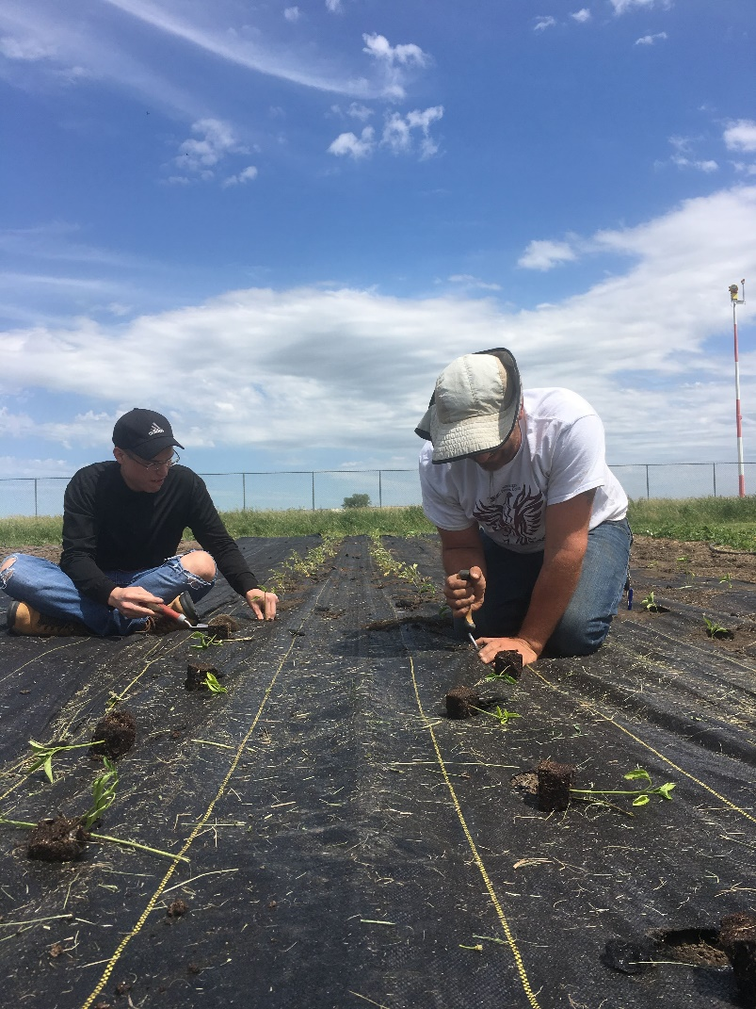
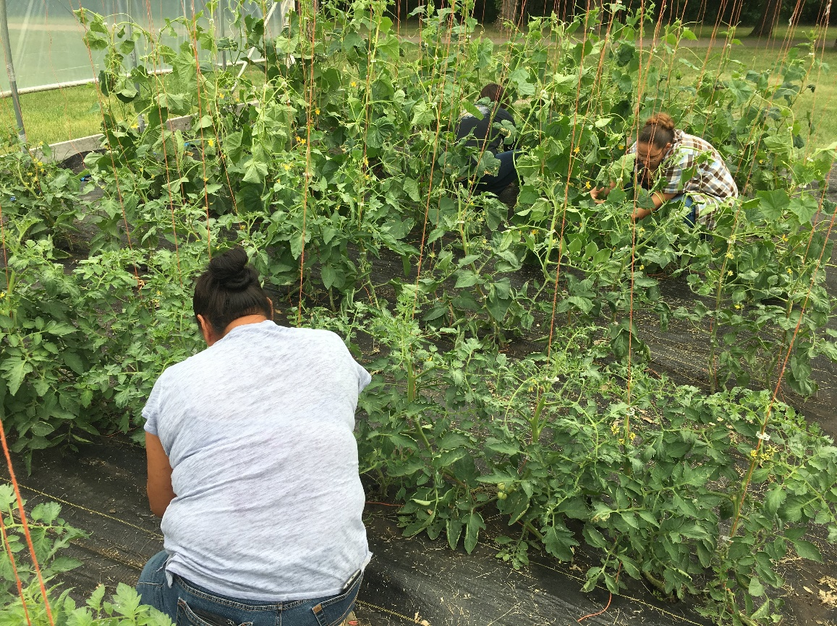
Notes:
Brian

Slide 21
Notes:
Brian

Slide 22
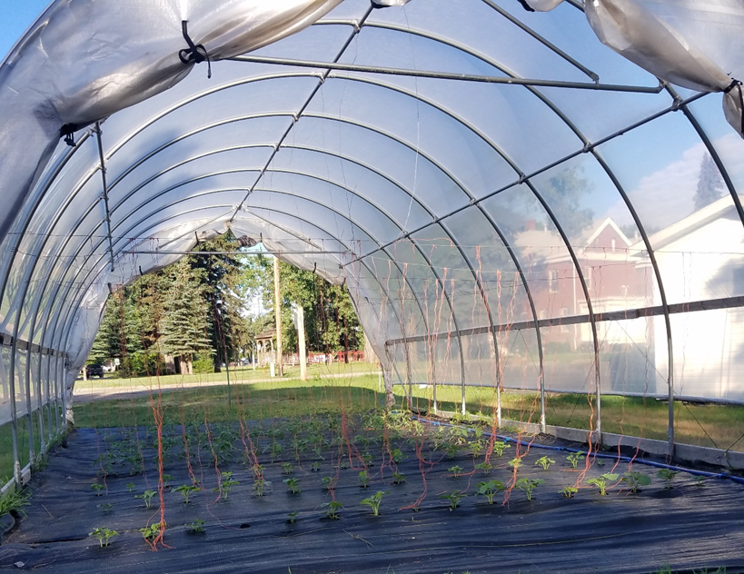
Part 3: What UTTC Land Grant Is Doing in 2019
Greenhouses
CSA
Workshops
Farm-To-Table

Slide 23
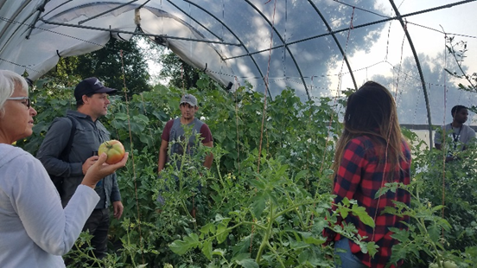
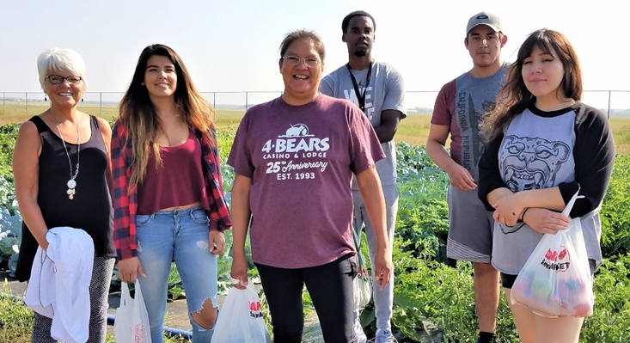
Part 3: What UTTC Land Grant Is Doing in 2019
Invitation to see our engagement outreach as an opportunity to expand, to improve the health of our mind, body and spirit, and to deepen our sense of community.

Slide 24
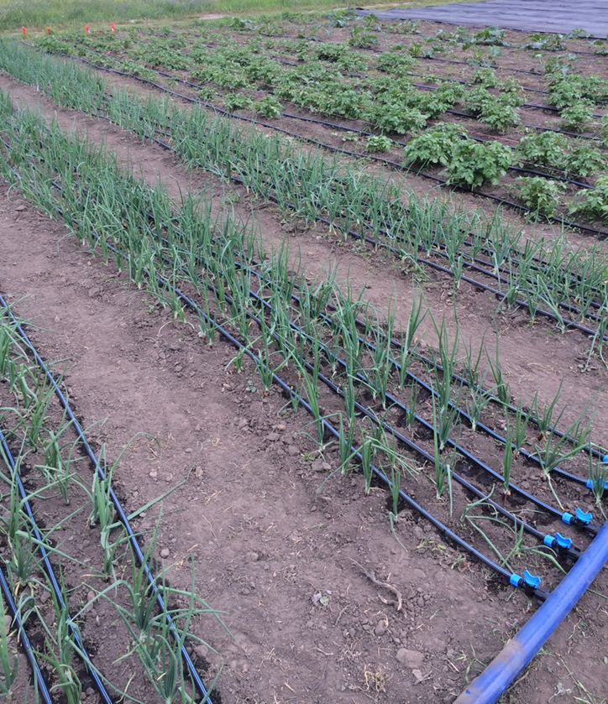
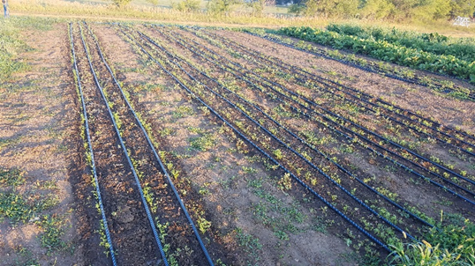
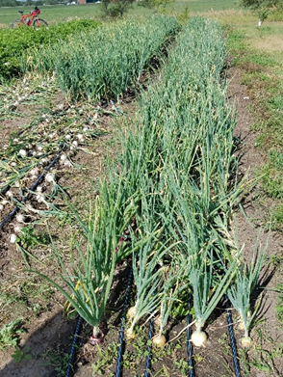
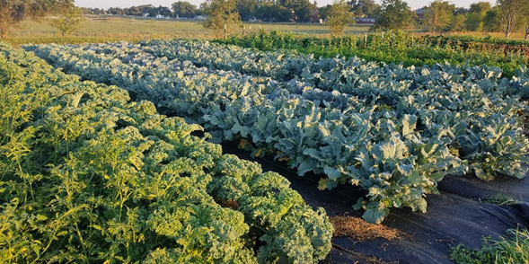
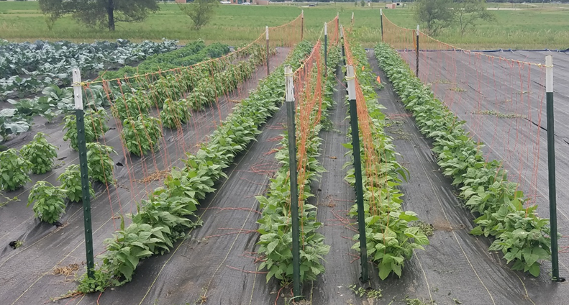
Notes:
Robert

Slide 25
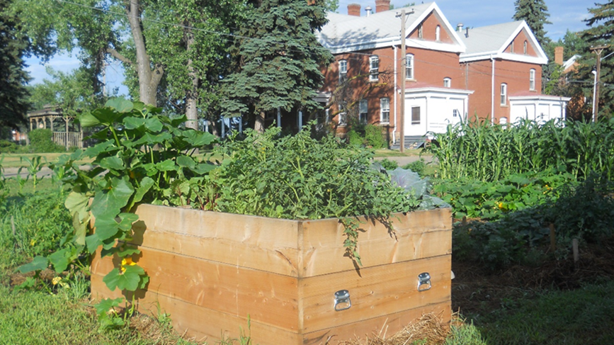
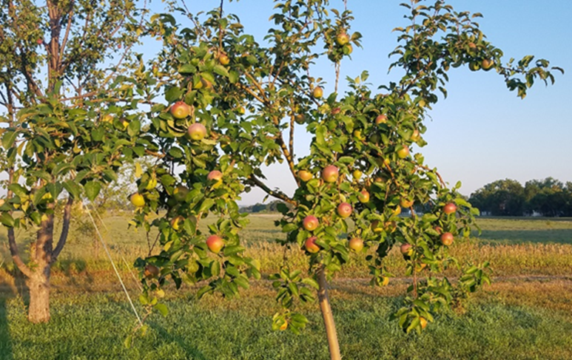
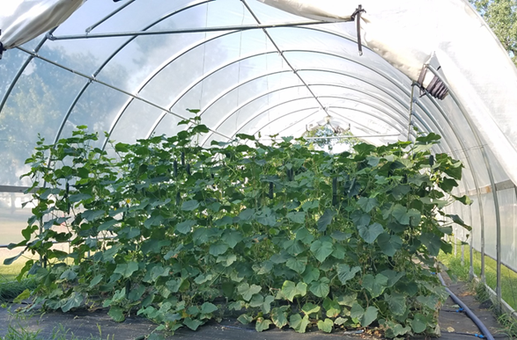
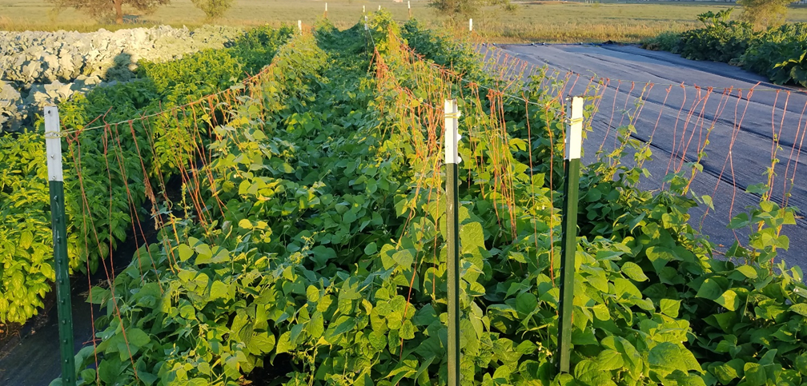
Notes:
Robert

Slide 26
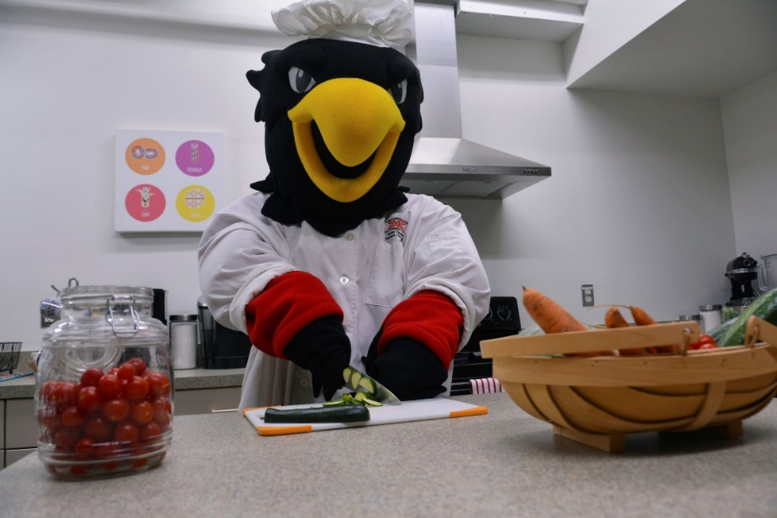

Slide 27
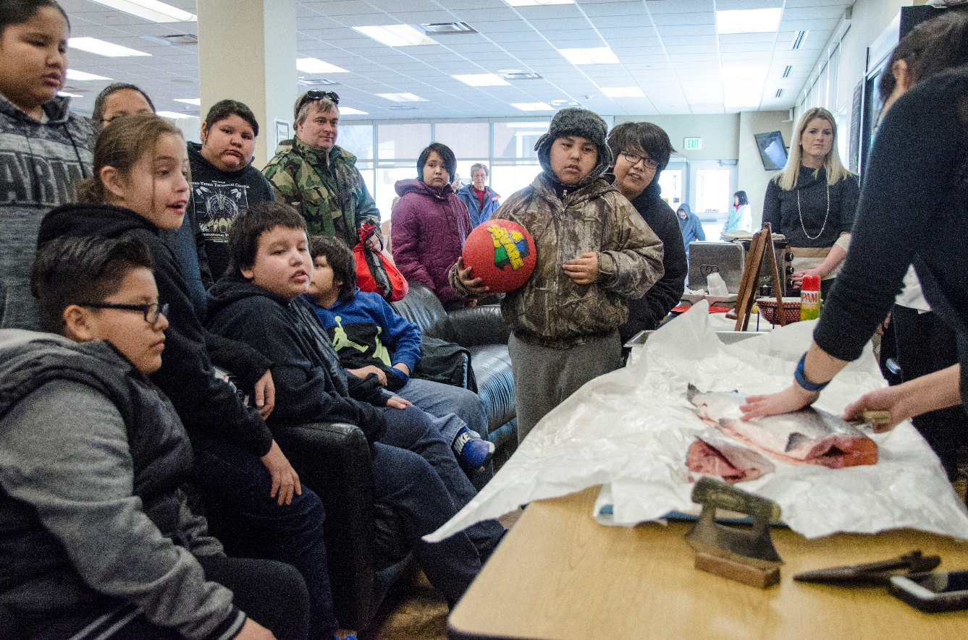

Slide 28
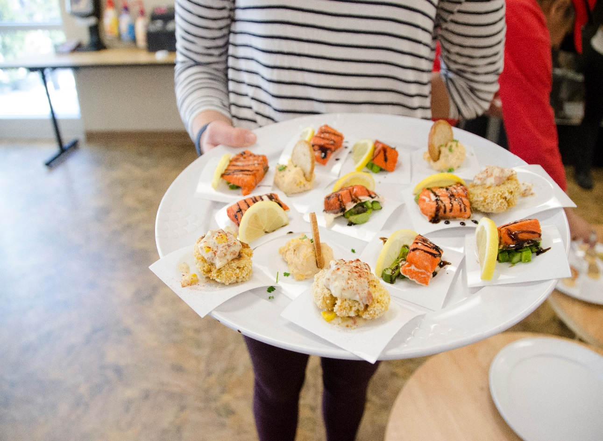

Slide 29
Thank You! Questions?

