Slide 1
Climate Resilience Toolkits
Anna Bahnson
Tribal Science Outreach Coordinator
Intertribal Research & Resource Center at United Tribes Technical College

Slide 2
Climate Adaptation and Resilience
“Our lands and resources are the basis for our spiritual life. That’s been our way since time began. By preparing for further environmental change, we can mitigate threats to our way of life.”
-Joe Durglo, Chairman of the Confederated Salish and Kootenai Tribes, Climate Change Strategic Plan for the Confederated and Salish and Kootenai Tribes of the Flathead Reservation.

Slide 3
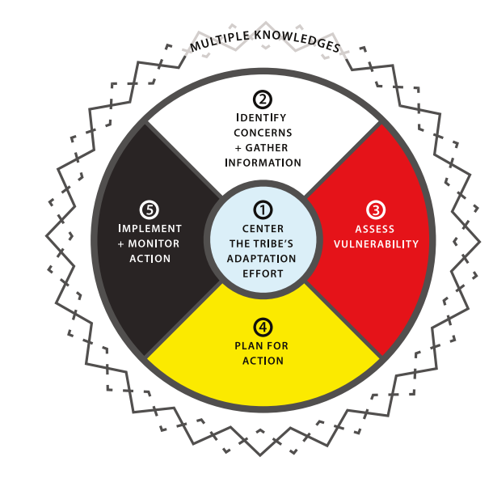
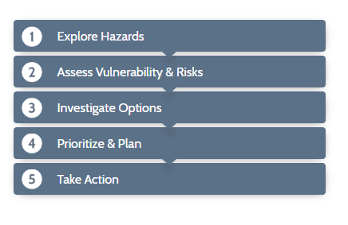
Steps to Resilience
https://toolkit.climate.gov
http://www.occri.net/projects/tribal-climate-adaptation-guidebook/
Notes:
Brief intro to these toolkits and the similar steps to resilience. Click on right toolkit to play video

Slide 4
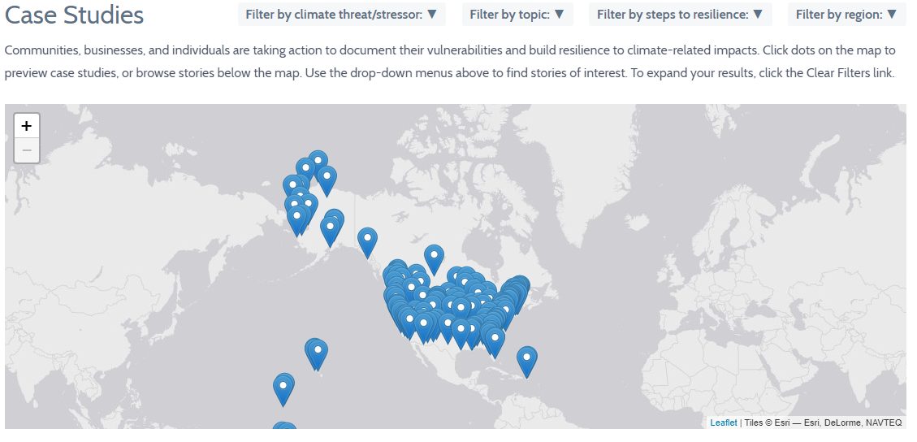
How are other communities preparing?
https://toolkit.climate.gov/case-studies
Notes:
Click on the link to show interactive case studies map of communities who are following the “Steps to Resilience”

Slide 5
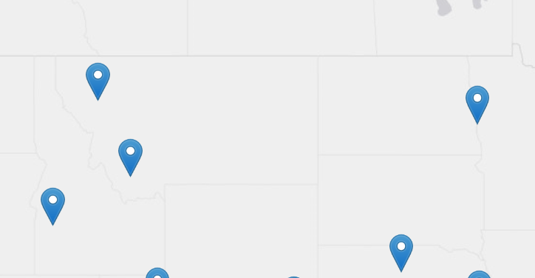
Case Studies
Confederated Salish and Kootenai Tribes: Applying the Values Taught by Our Ancestors
Moving Forward Together: Building Tribal Resiliency and Partnerships
Drought Resiliency Planning Prepares Stakeholders for New Conditions
Improving Communication of Flood Forecasts
Early Warning Information Increases Options for Drought Mitigation
1.
4.
3.
2.
5.
Notes:
Just read and reference where each case is based out of.

Slide 6
Read and Discuss Cases
Meet back here in 60 minutes
Notes:
Hand out cases, discussion questions, flip chart paper and markers.
What are some climate related impacts discussed in the case?
Who are the important stakeholders in this case?
How are the stakeholders working together to build resiliency, what are some specific adaptation strategies or tools are they utilizing?
How might the lessons learned from this case apply to your workplace/community?
When groups return Anna and James lead group share out.

Slide 7
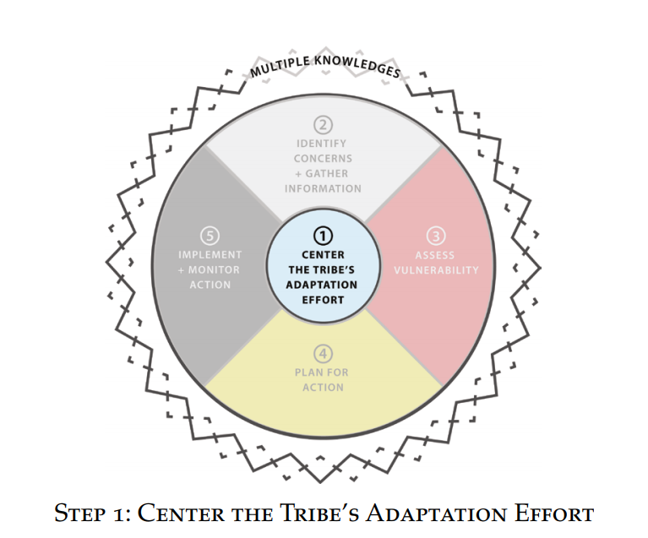
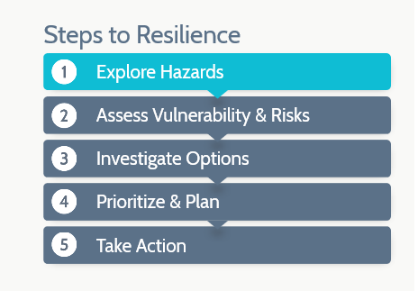
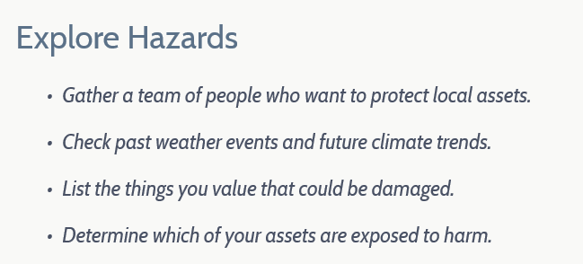
Steps to Resilience
Notes:
Who is here? Who are we missing that should be involved in these conversations?

Slide 8
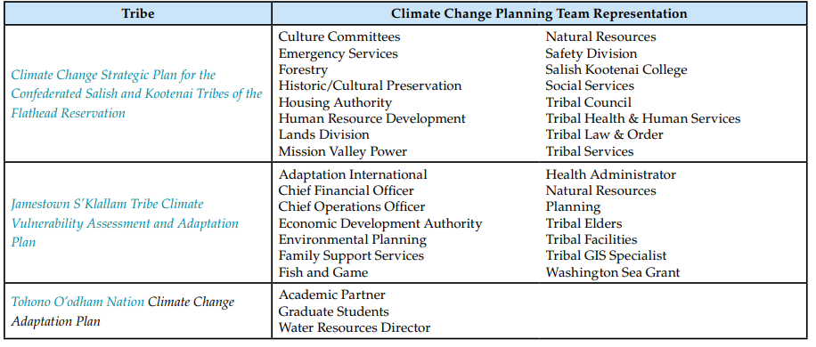
Example Climate Change Planning Teams
-Tribal Climate Adaptation Guidebook, pg. 23
Notes:
Compare this list from tribes that have written adaptation plans to the list generated by group. Gives additional ideas of potential stakeholders.

Slide 9
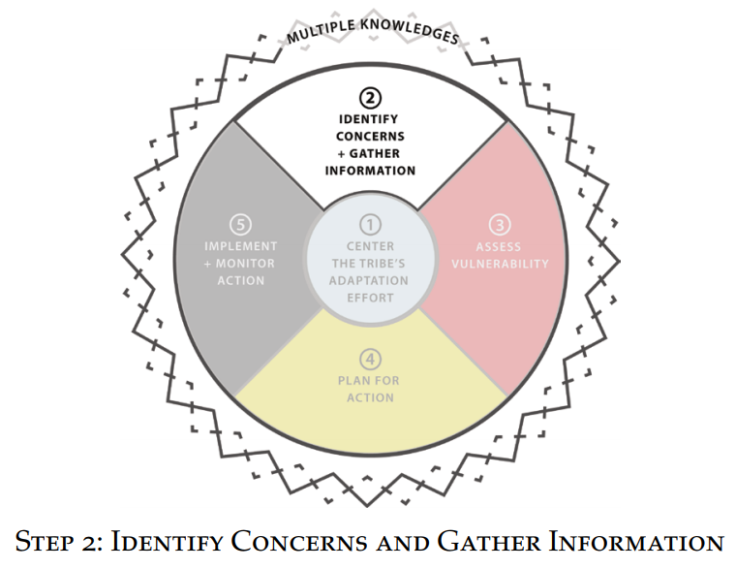
Steps to Resilience
Notes:
Explain where we will go after lunch with additional presentations
Break for lunch/group photo

Slide 10
Steps to Resilience

Slide 11
Identify and Organize Key Concerns
Guiding Questions
What aspects of the community or resources the tribe depends on are being affected or are likely to be negatively affected by climate change in the future?
Which resources, assets, or species are particularly critical to the community?
Consider cultural value, traditional value, social value, economic value, and ecosystem value
Notes:
15 minutes in small group with flip chart paper,
report out & discussion
wrap up.
In wrap up and next steps

Slide 12
Resources
The primary sources for this powerpoint content and images are from the Tribal Climate Adaptation Guide and the U.S. Climate Resiliency Toolkit.

